Slide 1
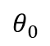
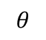

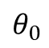
d
Source
d = 0
Detector
H
$$θ$$
$$θ$$
$$θ_{0}$$
$$θ_{0}$$
Crystal
x
L
L/2

Slide 2
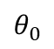
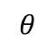
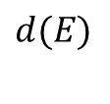

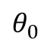
$$d(E)$$
Source
Detector
$$θ$$
$$θ$$
$$θ_{0}$$
$$θ_{0}$$
Crystal

Slide 3
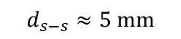
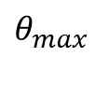
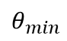
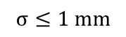
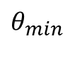
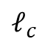
$$d_{s−s}≈5 mm$$
Source
$$θ_{min}$$
Sample
$$σ≤1 mm$$
z
x
Ion beam
(Future Experiment)
$$θ_{max}$$
$$θ_{min}$$
Crystal
$$ℓ_{c}$$

Slide 4

Source
Sample
$$1 mm$$
Ion beam
(Future Experiment)
$$θ_{max}$$
$$θ_{min}$$
Crystal

Slide 5
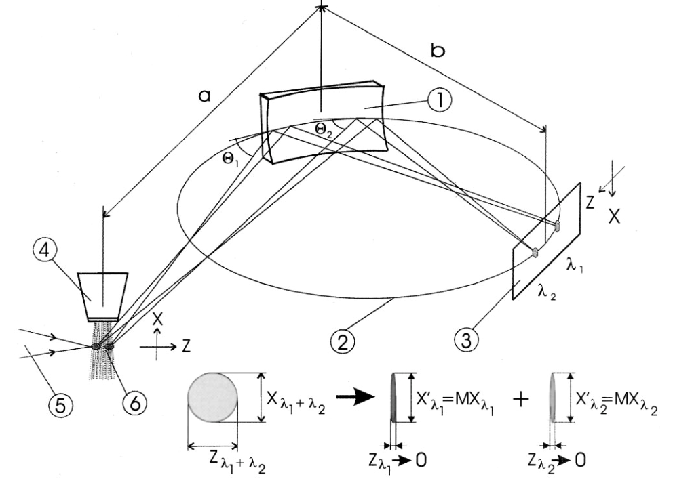
0
0

Slide 6
(2)
(3)
(6)
(4)
Pinhole
(1)
(5)

Slide 7
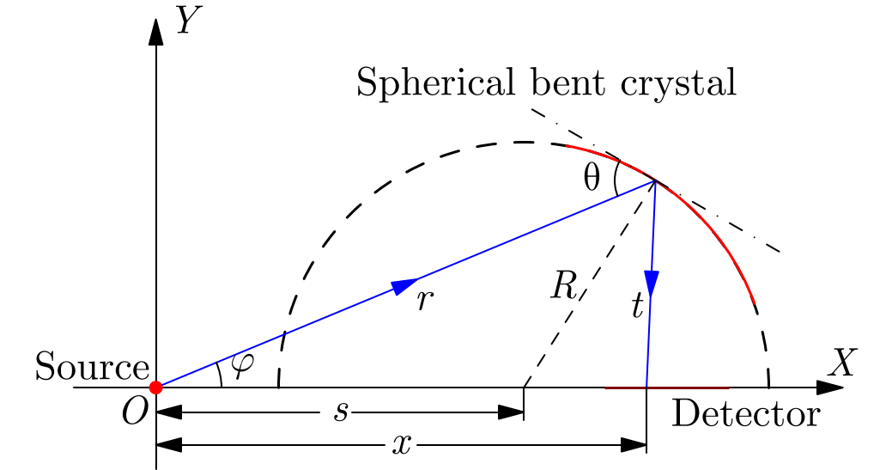




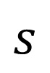
$$θ$$
$$α$$
a
R
b
$$φ$$
$$s$$
$$x$$

Slide 8
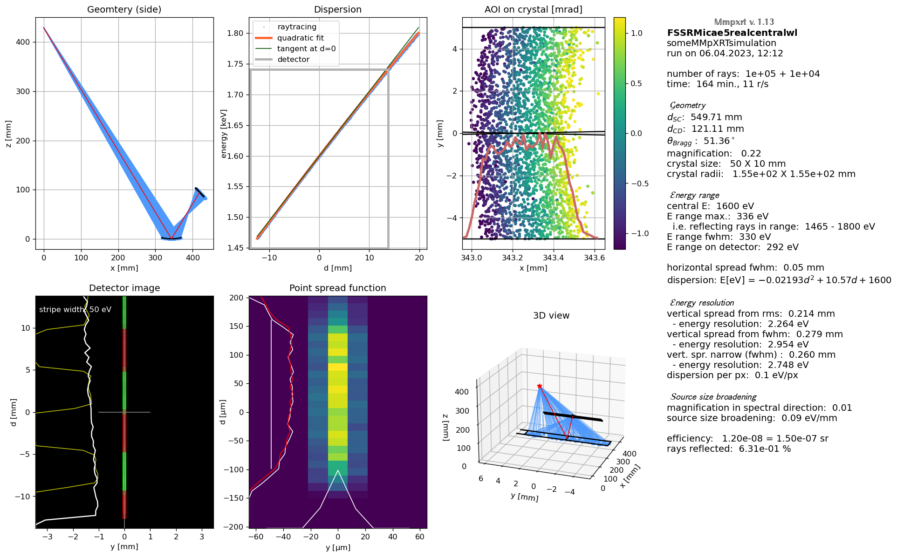
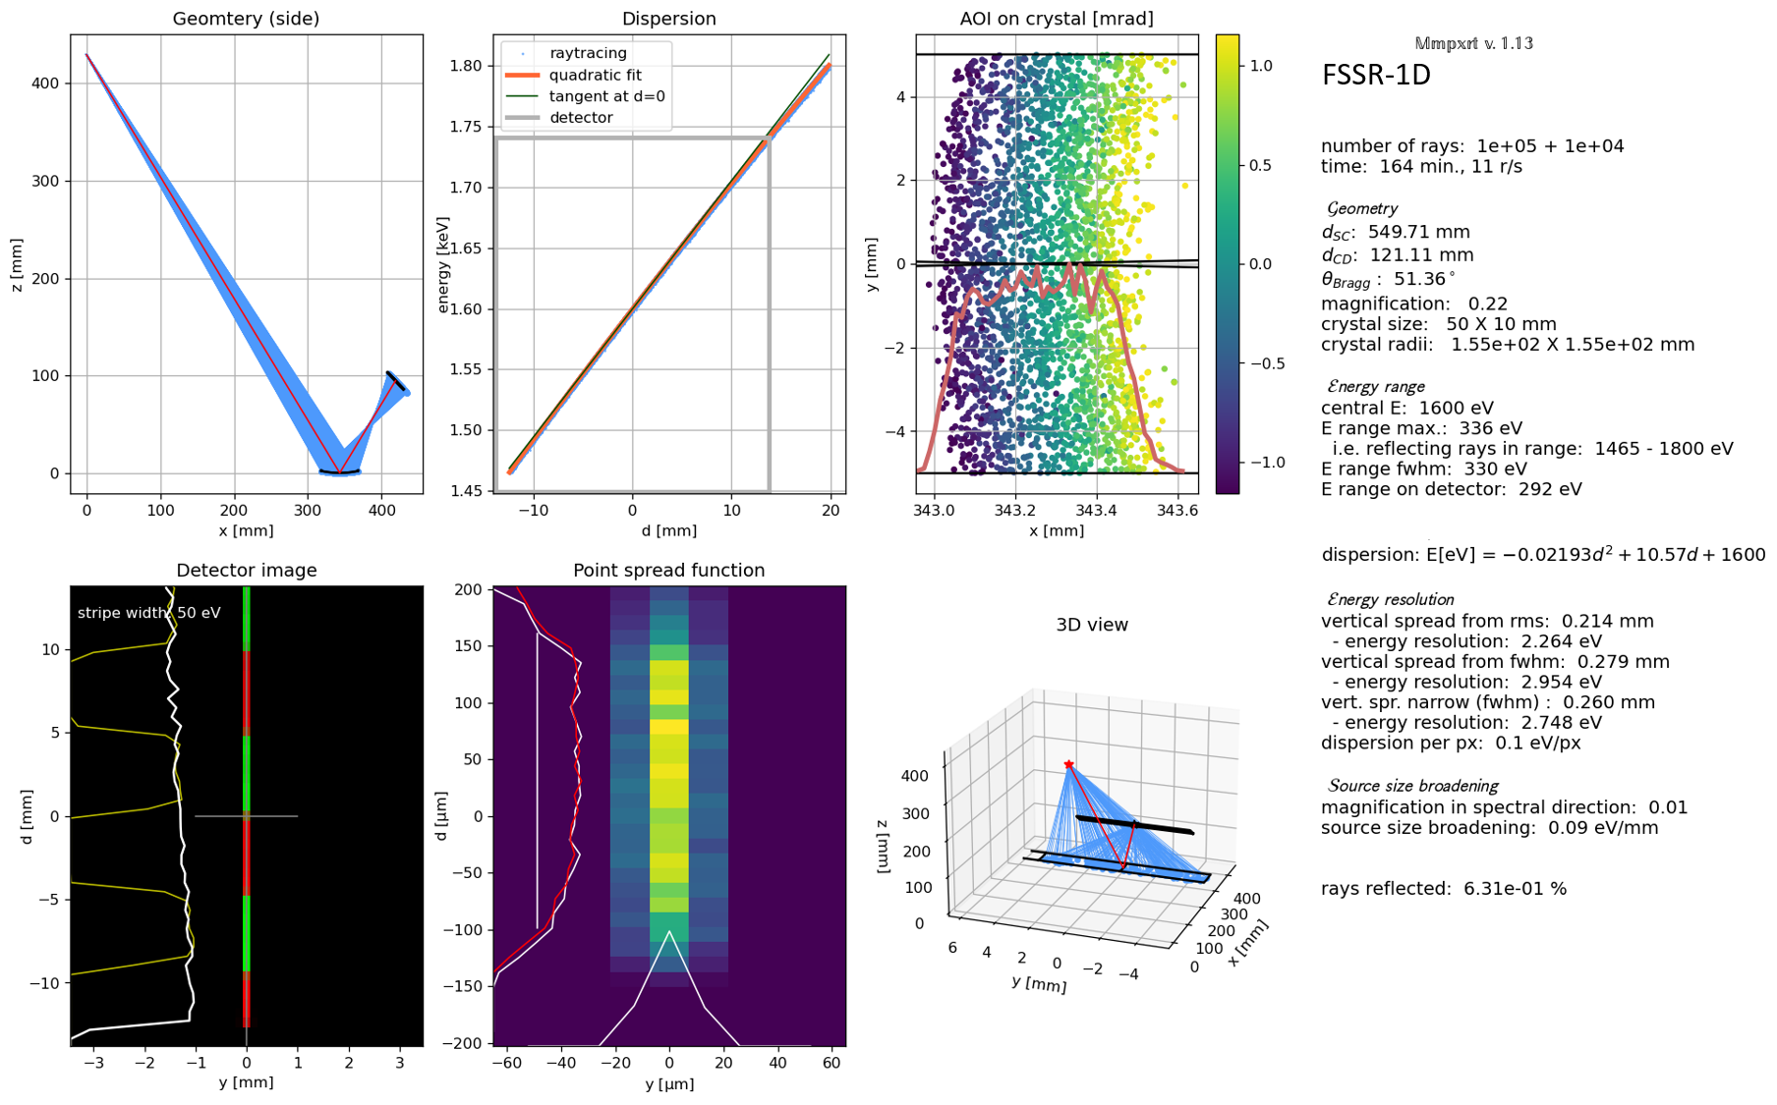
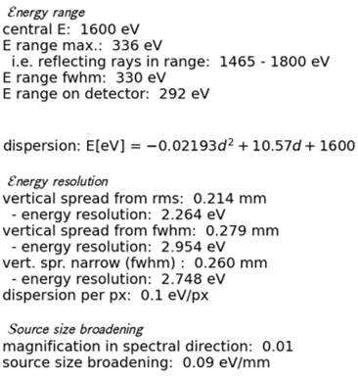
FSSR-1D

Slide 9
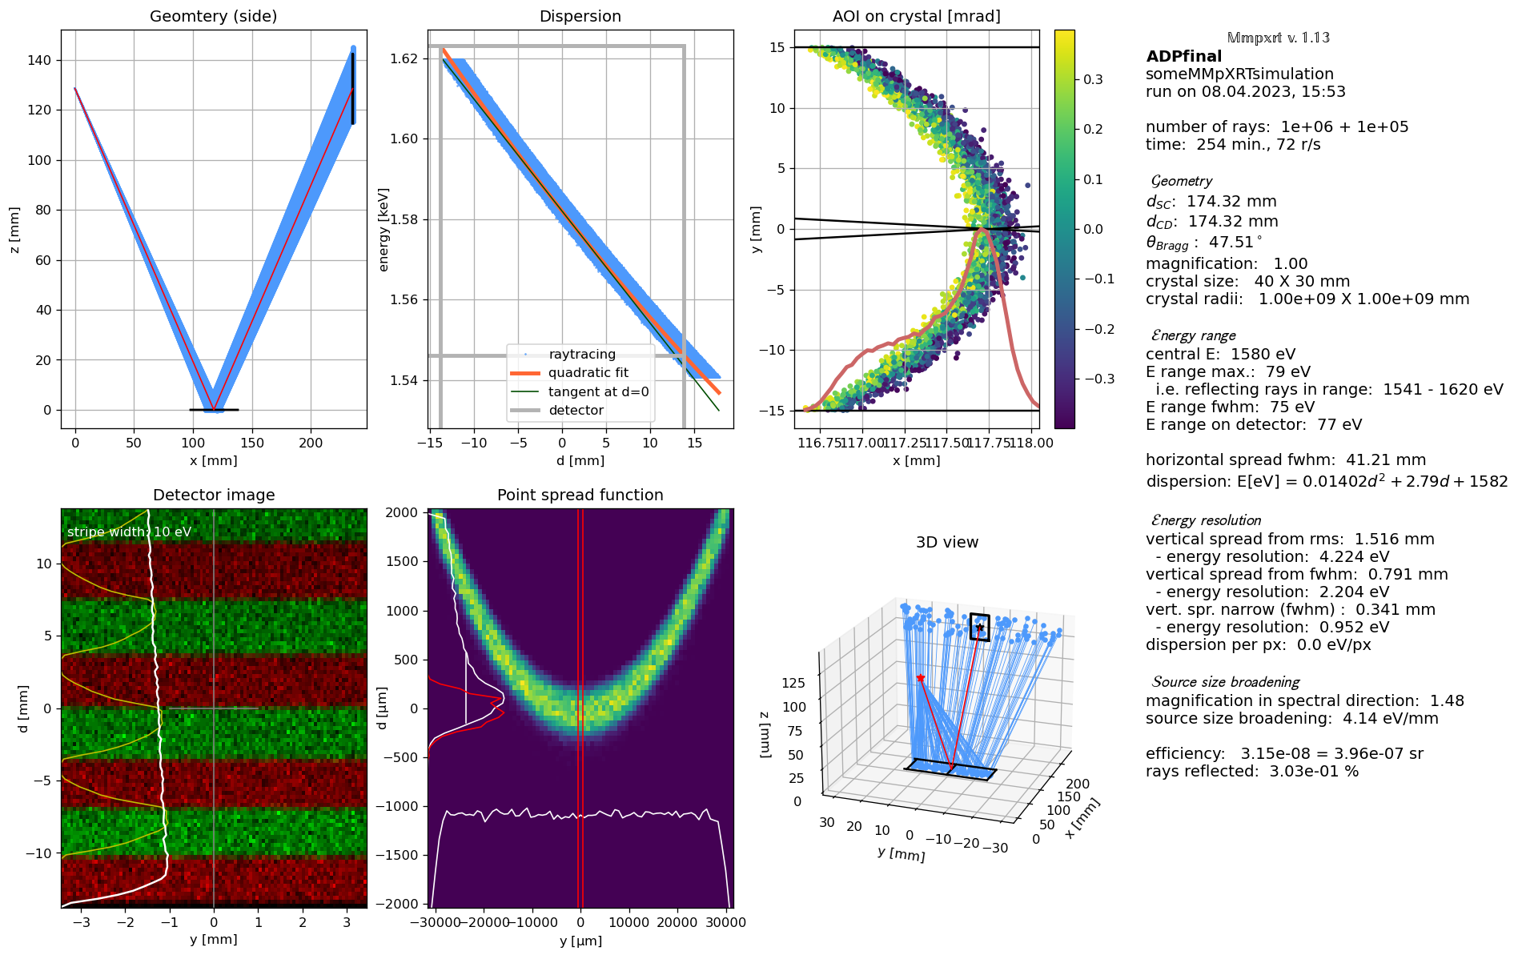
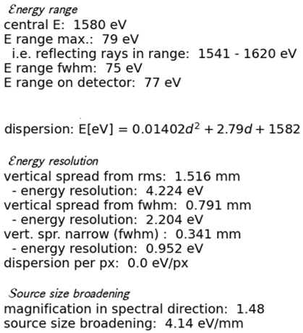
DUCC Spectrometer
DUCK

Slide 10
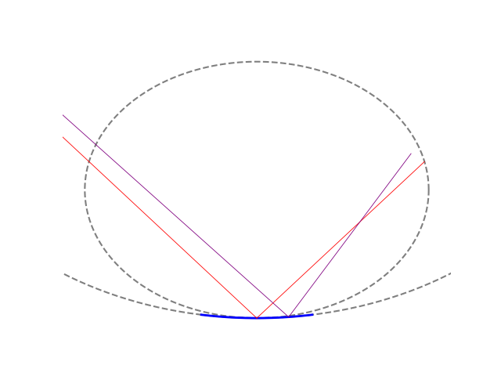
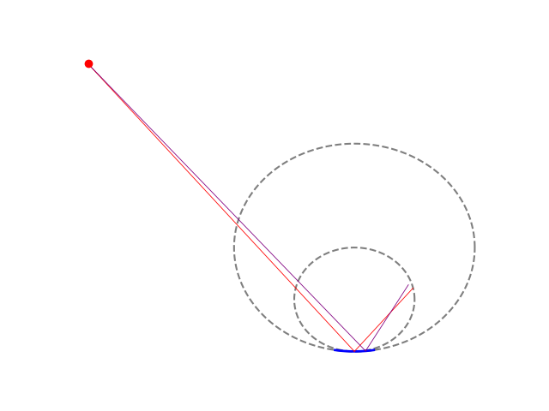
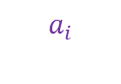


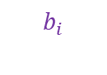
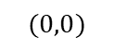
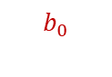
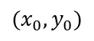

$$(x_{0},y_{0})$$
$$b_{0}$$
$$b_{i}$$
$$a_{i}$$
$$a_{0}$$
$$(0,0)$$
$$y$$
$$x$$

Slide 11
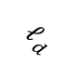


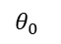

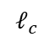
$$ℓ_{d}$$
$$b_{0}$$
$$θ_{0}$$
$$C_{1}$$
$$R$$
$$a_{0}$$
$$C_{2}$$
$$ℓ_{c}$$
L

Slide 12


Crystal
Target
Detector
Laser Beam
Sample
$$E_{s}$$
$$E_{t}$$
Ion beam
(Future Experiment)
Crystal
View on Detector

Slide 13
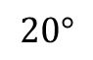
Target
Laser Beam
$$20°$$
Sample
Crystal
Detector

Slide 14
View on Detector
$$E_{s}$$
$$E_{t}$$
Target
Laser Beam
$$20°$$
Sample
Crystal
Camera Chip

Slide 15
X-Ray
Camera
Location of Future Ion Beam
SUCC
Spectrometer
Backlighter
PHELIX
Focus
Diagnostics
X-Ray
Camera
DUCC Spectrometer
Al Sample
FSSR-1D
Spectrometer
X-Ray
Camera

Slide 16
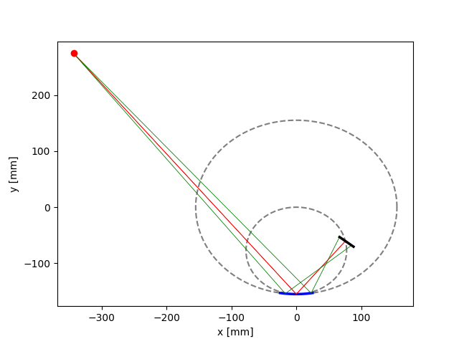

Slide 17
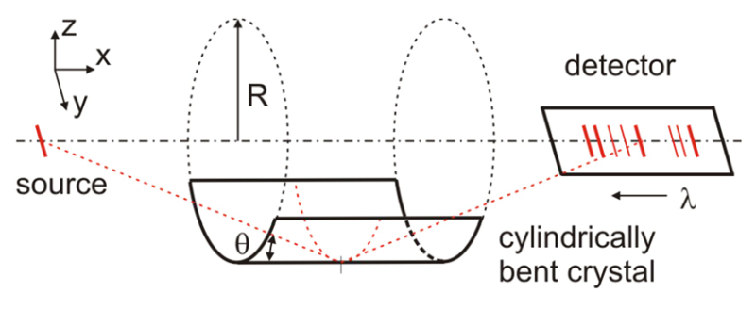

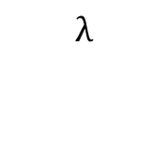
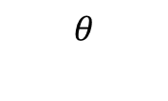
Z
X
$$R$$
Detector
Y
Source
$$λ$$
Cylindrically Bent Crystal
$$θ$$

Slide 18
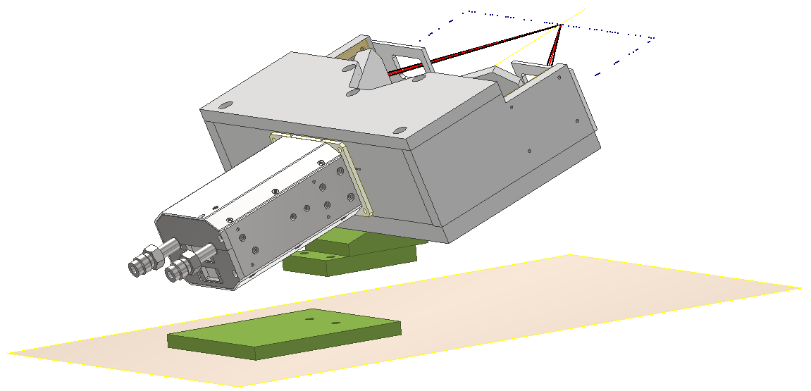
Greateyes Camera
Venting Channel

Slide 19
Greateyes Camera

Slide 20
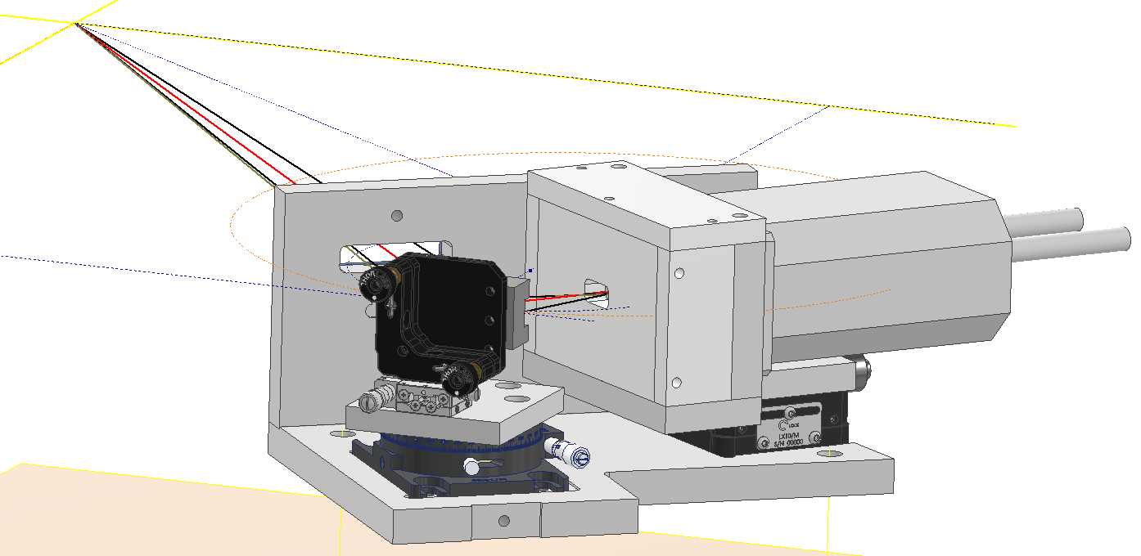
Greateyes Camera

Slide 21
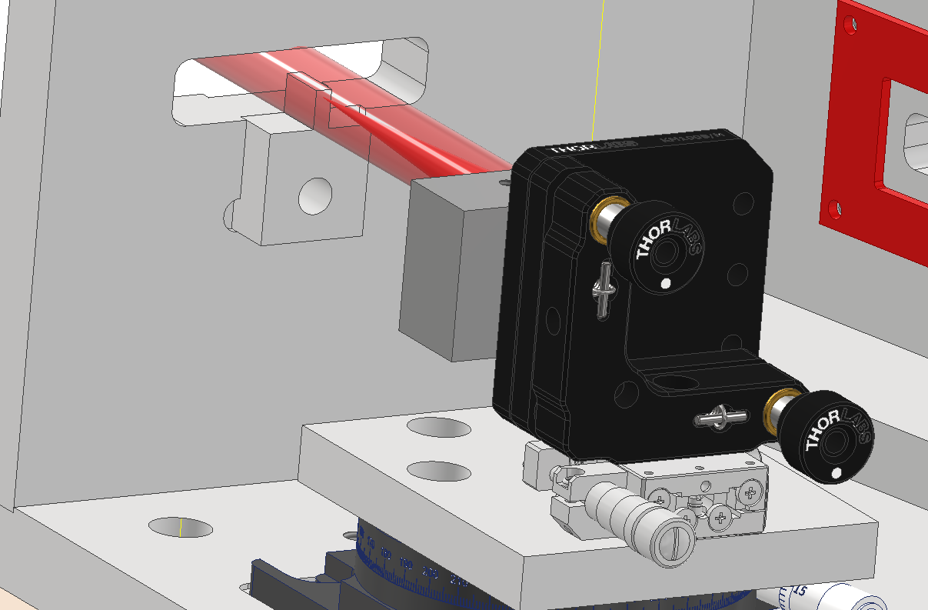
Tip-tilt stage
Fine linear stage

Slide 22
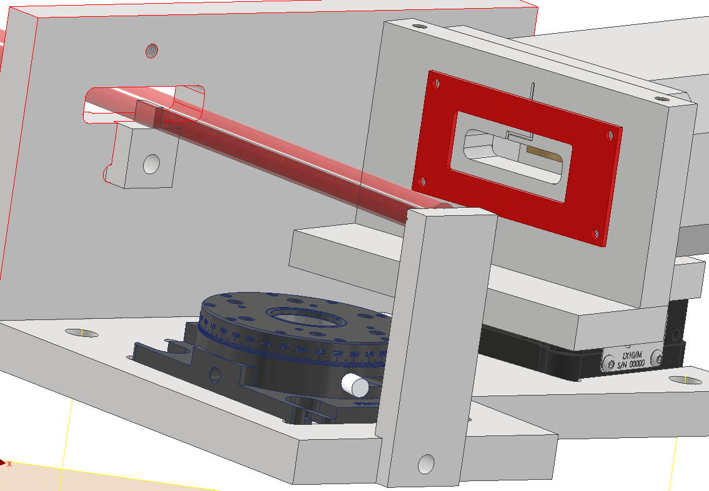
Rotation stage
Large linear stage

Slide 23
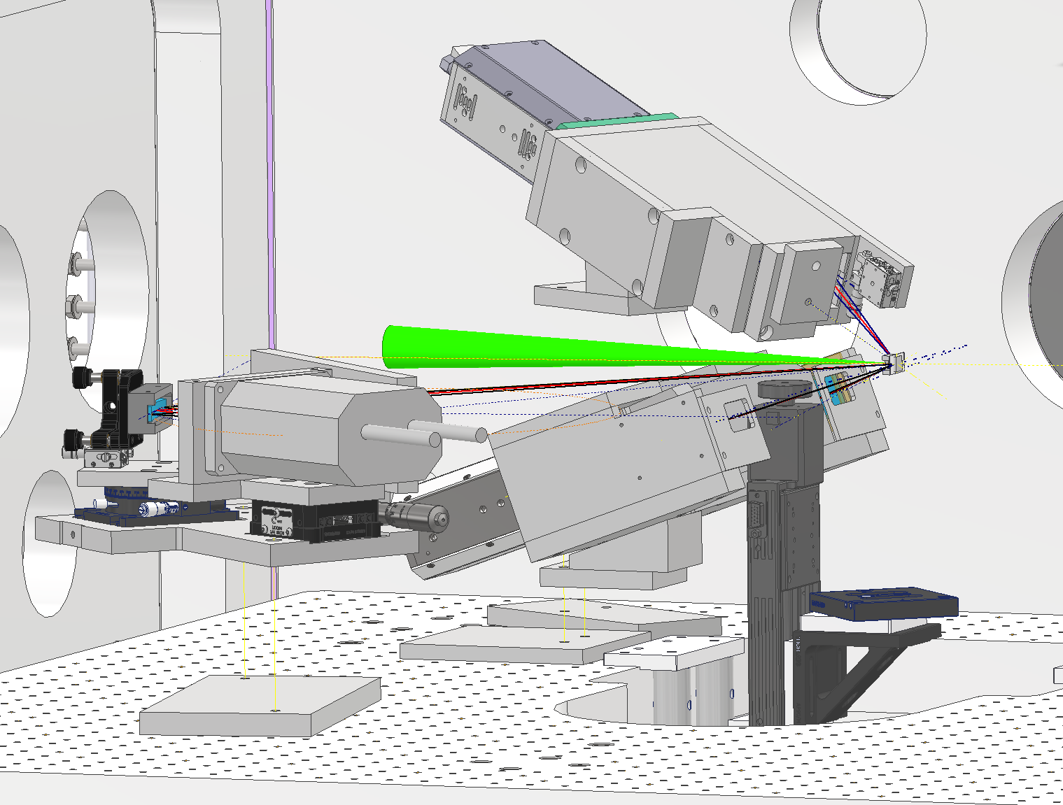
SUCC
PHELIX
FSSR-1D
Backlighter with sample
DUCC

Slide 24
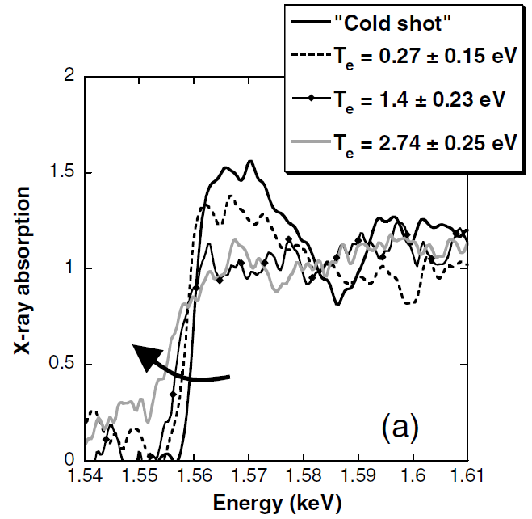
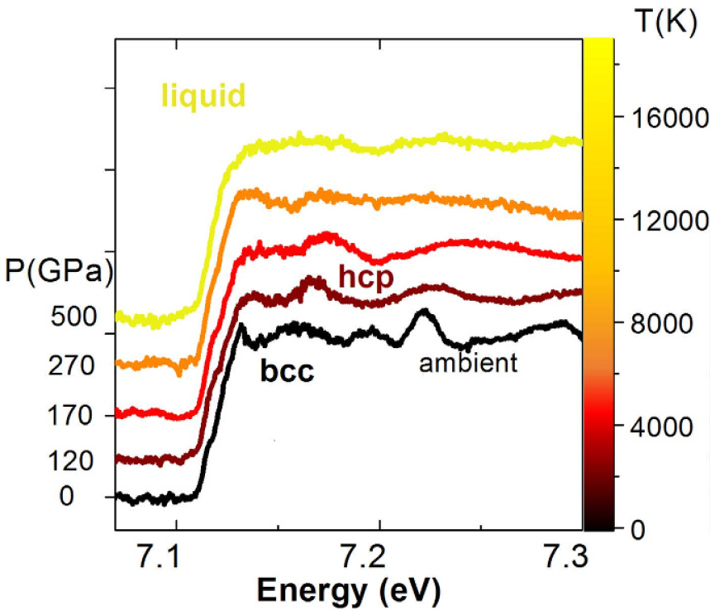
a)
b)

Slide 25
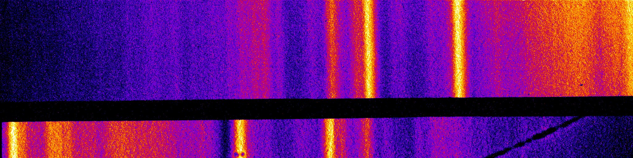
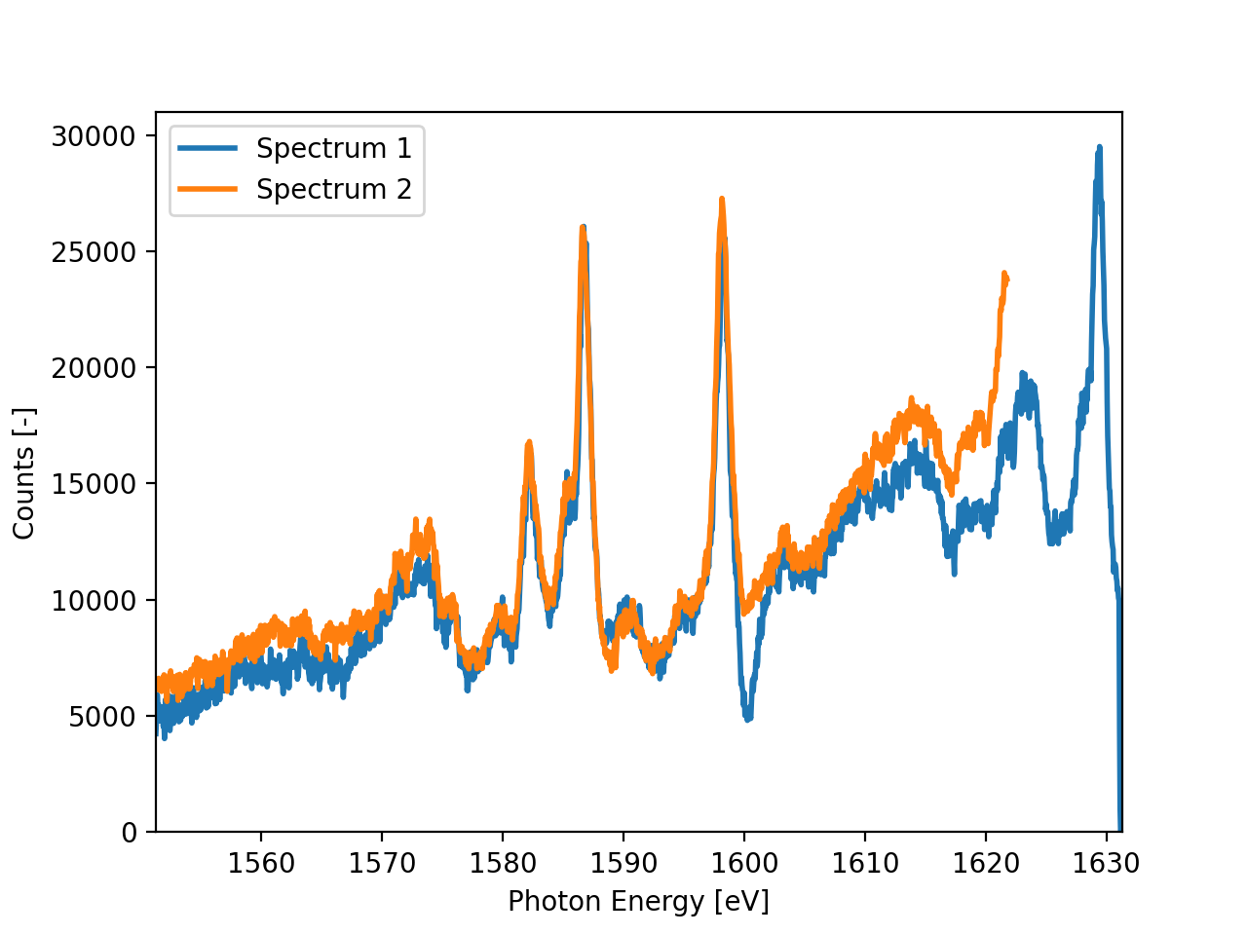
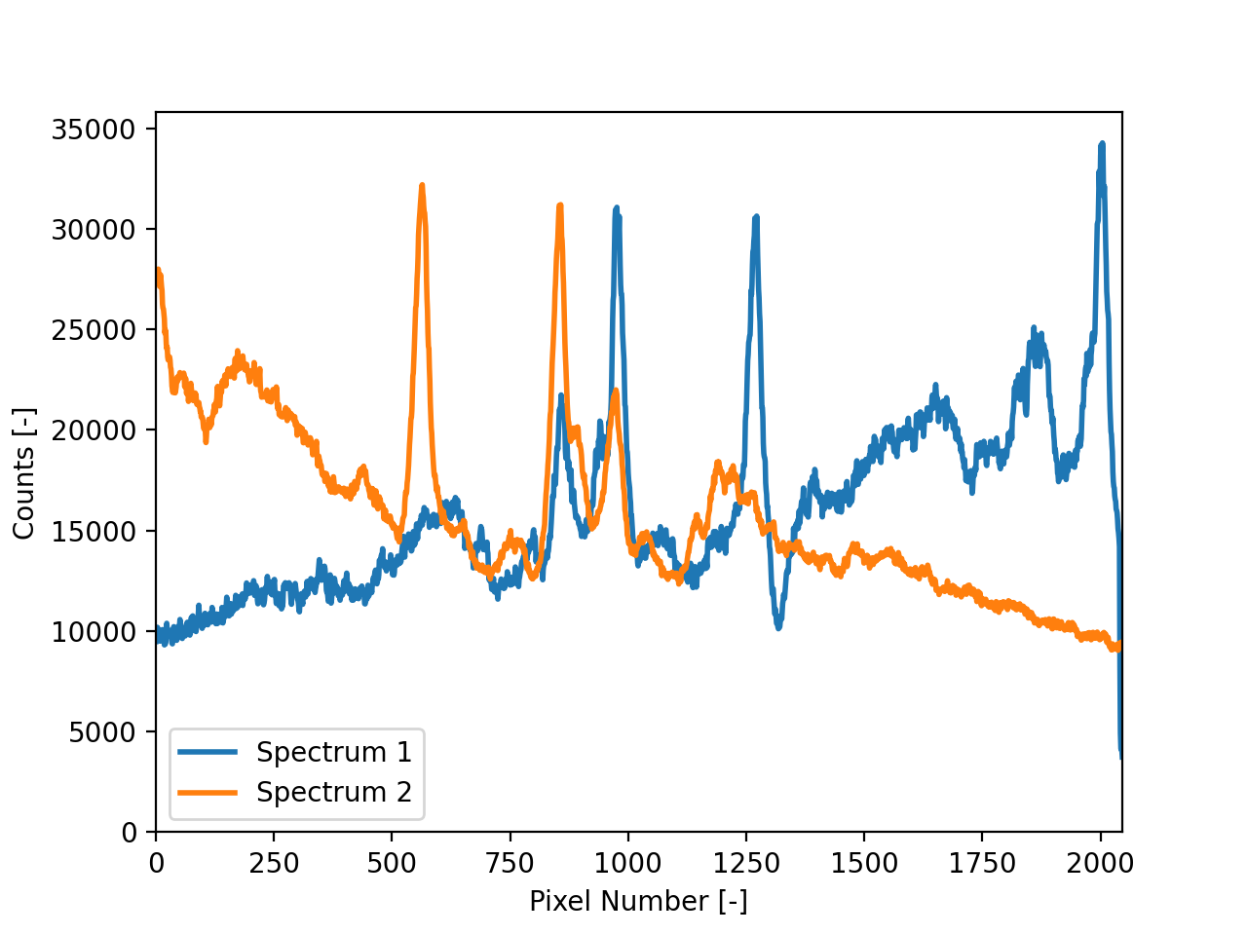
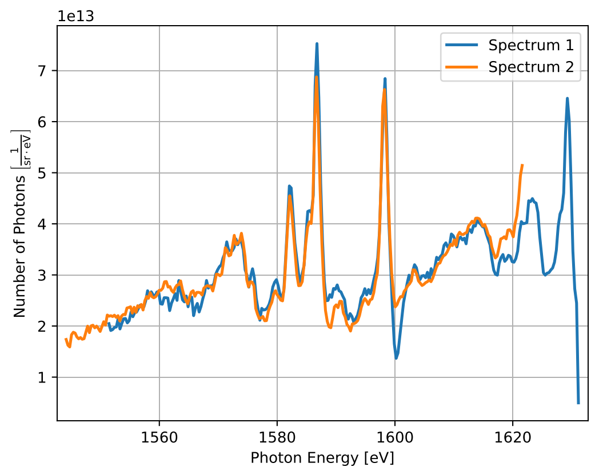
Dispersion
Spectrum 1
Background
Spectrum 2
Correct out filters, camera effects, and geometry, then bin the data
Take line outs of each section
Flip spectra if needed, correct background, and convert pixel number to photon energy with dispersion d(E)

Slide 26
Backlighter
Target
Laser-driven
Plasma
Intense Laser
WDM
Sample
Cold
Sample
X-rays
Heavy-ion
Beam

